Slide 1


Noida Institute of Engineering and Technology, Greater Noida
Operating System
ACSE0403A
Unit: 2
Process Management
SANCHI KAUSHIK
Assistant Professor
Department of AIML
B. Tech 4th Semester

Slide 2

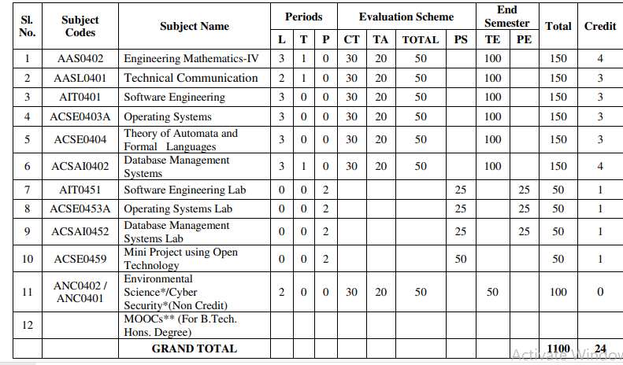
Evaluation Scheme

Slide 3
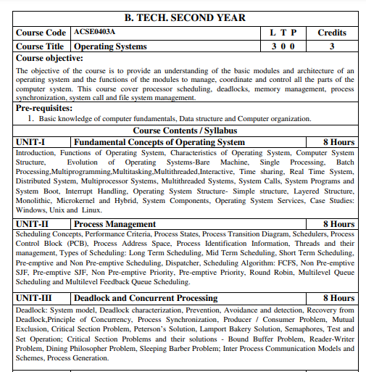
Subject Syllabus

Slide 4
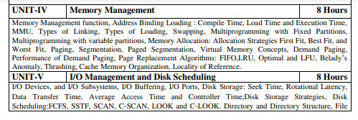

Subject Syllabus

Slide 5
Syllabus For Unit-2
UNIT-I Fundamental Concepts of Operating System
Scheduling Concepts, Performance Criteria, Process States, Process Transition Diagram, Schedulers, Process Control Block (PCB), Process Address Space, Process Identification Information, Threads and their management, Types of Scheduling: Long Term Scheduling, Mid Term Scheduling, Short Term Scheduling, Preemptive and Non Pre-emptive Scheduling, Dispatcher, Scheduling Algorithm: FCFS, Non Pre-emptive SJF, Preemptive SJF, Non Pre-emptive Priority, Pre-emptive Priority, Round Robin, Multilevel Queue Scheduling and Multilevel Feedback Queue Scheduling.

Slide 6
Branch wise Applications
Airlines reservation system.
Air traffic control system.
Systems that provide immediate updating.
Used in any system that provides up to date and minute
information on stock prices.
Defense application systems like RADAR.
Networked Multimedia Systems.
Command Control Systems.

Slide 7
Course Objectives
Provide an understanding of the basic modules and architecture of an operating system and the functions of the modules to manage, coordinate and control all the parts of the computer system.
Processor scheduling, deadlocks, memory management, process synchronization, system call and file system management.

Slide 8
Course Outcomes
Course outcome: After completion of this course students will be able to:
CO 1 | Understand the fundamentals of an operating systems, functions and their structure and functions. | K1, K2
CO2 | Implement concept of process management policies, CPU Scheduling and thread management. | K5
CO3 | Understand and implement the requirement of process synchronization and apply deadlock handling algorithms. | K2,K5
CO4 | Evaluate the memory management and its allocation policies. | K5
CO5 | Understand and analyze the I/O management and File systems | K2, K4

Slide 9
Program Outcomes
1. Engineering knowledge
2. Problem analysis
3. Design/development of solutions
4.Conduct investigations of complex problems
5. Modern tool usage
6. The engineer and society
7. Environment and sustainability
8. Ethics:
9. Individual and team work
10. Communication
11. Project management and finance
12. Life-long learning

Slide 10
COs and POs Mapping
OPERATING SYSTEM (ACSE0403A )
Sub CODE | PO1 | PO2 | PO3 | PO4 | PO5 | PO6 | PO7 | PO8 | PO9 | PO10 | PO11 | PO12
ACSE0403A .1 | 3 | 3 | 2 | 2 | 1 | 2 | - | 2 | 3 | 2 | 2 | 3
ACSE0403A .2 | 3 | 3 | 3 | 2 | 2 | 3 | - | 2 | 3 | 1 | 1 | 3
ACSE0403A .3 | 3 | 3 | 2 | 2 | 2 | 2 | - | 2 | 2 | 3 | 1 | 3
ACSE0403A .4 | 3 | 2 | 2 | 3 | 1 | 2 | - | 1 | 2 | 1 | 2 | 3
ACSE0403A .5 | 3 | 1 | 2 | 2 | 2 | 2 | - | 1 | 2 | 2 | 2 | 3
Average | 3 | 2.4 | 2.2 | 2.2 | 1.6 | 2.2 | - | 1.8 | 2.2 | 1.8 | 1.6 | 3

Slide 11
Program Specific Outcomes(PSOs)
On successful completion of B. Tech. (I.T.) Program, the Information Technology graduates will be able to:
PSO1:- Work as a software developer, database administrator, tester or networking engineer for providing solutions to the real world and industrial problems.
PSO2:- Apply core subjects of information technology related to data structure and algorithm, software engineering, web technology, operating system, database and networking to solve complex IT problems.
PSO3:-Practice multi-disciplinary and modern computing techniques by lifelong learning to establish innovative career.
PSO4:-Work in a team or individual to manage projects with ethical concern to be a successful employee or employer in IT industry.

Slide 12
COs and PSOs Mapping
Course Outcomes | Program Specific Outcomes
 | PSO1 | PSO2 | PSO3 | PSO4
ACSE0403A .1 | 2 | 1 | 2 | 2
ACSE0403A .2 | 2 | 2 | 1 | 2
ACSE0403A .3 | 2 | 3 | 3 | 2
ACSE0403A .4 | 2 | 2 | 1 | 2
ACSE0403A .5 | 2 | 2 | 2 | 2
Average | 2 | 2 | 1.8 | 2

Slide 13
Program Educational Objectives (PEOs)
PEO1:Apply sound knowledge in the field of information technology to fulfill the needs of IT industry.
PEO2:Design innovative and interdisciplinary systems through latest digital technologies.
PEO3:Inculcate professional – social ethics, team work and leadership for serving the society.
PEO4:Inculcate lifelong learning in the field of computing for successful career in organizations and R&D sectors.

Slide 14
Faculty wise Result Analysis
Semester & Section | Subject Code | Result

Slide 15
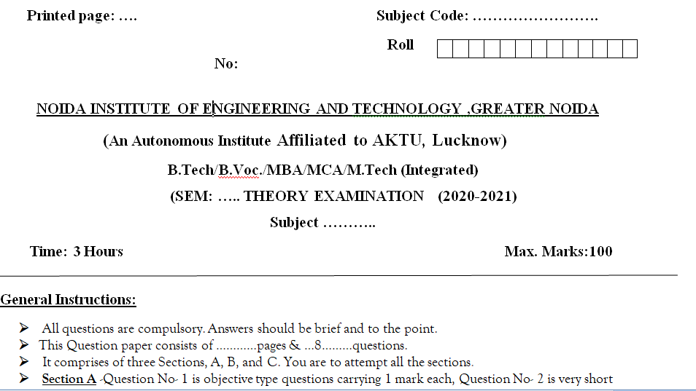
End Semester Question Paper Templates (Offline Pattern/Online Pattern

Slide 16
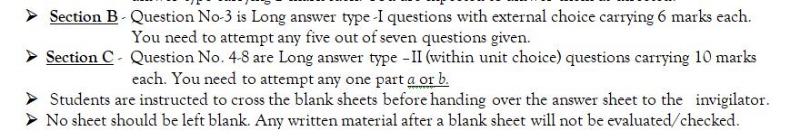
End Semester Question Paper Templates (Offline Pattern/Online Pattern

Slide 17
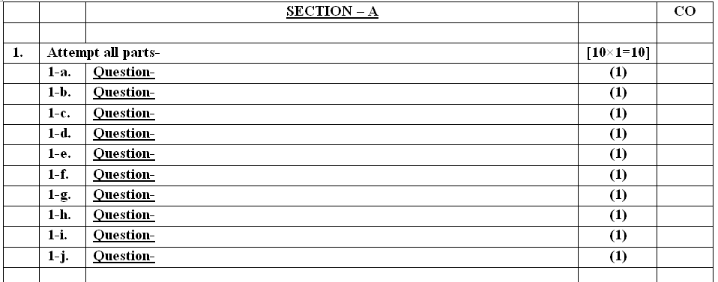
End Semester Question Paper Templates (Offline Pattern/Online Pattern

Slide 18
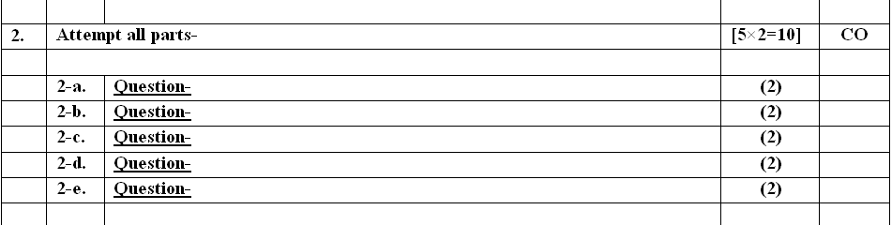
End Semester Question Paper Templates (Offline Pattern/Online Pattern

Slide 19
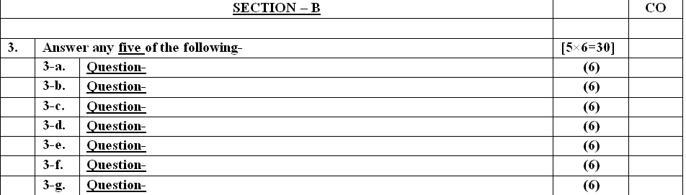
End Semester Question Paper Templates (Offline Pattern/Online Pattern

Slide 20
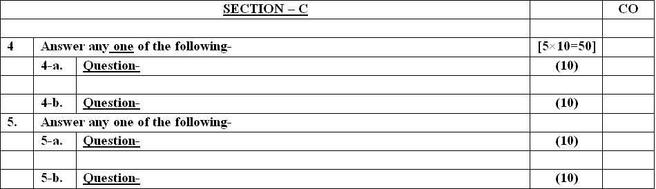
End Semester Question Paper Templates (Offline Pattern/Online Pattern

Slide 21

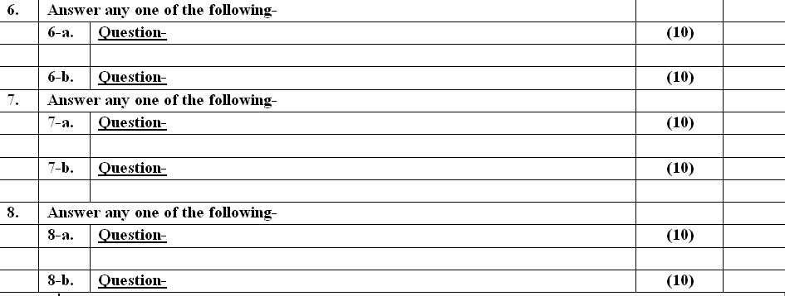
End Semester Question Paper Templates (Offline Pattern/Online Pattern

Slide 22
Prerequisite and Recap
Prerequisite
First get your computer hardware basics cleared.
Digital logic and it’s design (Basics will make understand storing memory and page faults, Difference between RAM and ROM. etc.,)
Computer Organization and Architecture( Design of Computer architecture will help you understand computer peripherals and its storages, accessing them in operating system )
Strong programming skills (Knowledge of C).
Recap
To Understood Types of operating system
To analyzed different structure of Operating system
To Understood the System calls and Function etc.

Slide 23
Objective of Unit 2
After going through this unit, you should be able to:
To examine issues related to multithreaded programming.
To introduce CPU scheduling, which is the basis for multiprogrammed operating systems.
To describe various CPU-scheduling algorithms.
To discuss evaluation criteria for selecting a CPU-scheduling algorithm for a particular system.
To examine the scheduling algorithms of several operating systems.
understand the concept of Process Concept, Process State and Process Control Block (PCB)
understand the concept of Threads.
compare and contrast different CPU scheduling algorithms.

Slide 24
Unit -Recap
To understand the basic concepts and components of operating systems
To understand computer system organization and structure.
To understand operating system services and types of system call.
Demonstrate the structure and functions of an operating system.
Compare between different operating systems.

Slide 25
Brief Introduction about the subject with video
An operating system acts as an intermediary between the user of a computer and computer hardware. The purpose of an operating system is to provide an environment in which a user can execute programs conveniently and efficiently
YouTube/other Video Links
https://www.youtube.com/playlist?list=PLmXKhU9FNesSFvj6gASuWmQd23Ul5omtD

Slide 26
Unit-2 Content
Scheduling Concept
Performance Criteria
Process Concept
Process State
Process Transition Diagram
Process Control Block (PCB)
Thread
User thread
Kernel thread
Single and Multithreaded Processes
Multithreading Models
Many-to-One
One-to-One
Many-to-Many Model

Slide 27
Unit-2 Content
Types of Schedulers
CPU Scheduling Algorithms
First Come First Serve(FCFS) Scheduling.
Shortest-Job-First(SJF) Scheduling.
Priority Scheduling.
Round Robin(RR) Scheduling.
Multilevel Queue Scheduling.
Multilevel Feedback Queue Scheduling.
Multiple-Processor Scheduling

Slide 28
Unit-2 Objective
After going through this unit, you should be able to:
understand the concept of Process Concept, Process State
and Process Control Block (PCB)
understand the concept of Threads.
compare and contrast different CPU scheduling algorithms.

Slide 29
Course Outcome of Unit 2
At the end of semester, students will be able to:
CO2: Implement concept of process management policies, CPU Scheduling and thread management

Slide 30
CO-PO Mapping
OPERATING SYSTEM(ACSE0403A)
CODE | PO1 | PO2 | PO3 | PO4 | PO5 | PO6 | PO7 | PO8 | PO9 | PO10 | PO11 | PO12
ACSE0403A.2 | 3 | 3 | 3 | 2 | 2 | 3 | 2 | -2 | 3 | - | 1 | 3

Slide 31
Topic mapping with CO
Topic | CO
Scheduling Concepts, Performance Criteria | CO2
Process States, Process Transition Diagram, Schedulers | CO2
Process Control Block (PCB), | CO2
Process Address Space, Process Identification Information | CO2
Threads and their management | CO2

Slide 32
Topic mapping with CO
Topic | CO
Types of Scheduling: Long Term Scheduling, Mid Term Scheduling, Short Term Scheduling | CO2
Preemptive and Non Pre-emptive Scheduling, Dispatcher | CO2
Dispatcher, Scheduling Algorithm | CO2
FCFS, Non Pre-emptive SJF | CO2
Preemptive SJF, Non Pre-emptive Priority | CO2

Slide 33
Topic mapping with CO
Topic | CO
Pre-emptive Priority | CO2
Round Robin | CO2
Multilevel Queue Scheduling | CO2
Multilevel Feedback Queue Scheduling. | CO2

Slide 34
Topic Objectives
Topic | Objective
 | Students will be able to
Process Management | Understand the Process
Types of Scheduling: Long Term Scheduling, Mid Term Scheduling, Short Term Scheduling | Understand the different types of scheduling
Scheduling Algorithm | Understand the Scheduling Concept
Non Pre-emptive Priority, Pre-emptive Priority, Round Robin | Understand the different types of Pre-emptive and non pre-emptive algorithm
Multilevel Queue Scheduling | Know the different types of multilevel queue scheduling

Slide 35
Introduction (CO2)
Process management involves various tasks like creation, scheduling, termination of processes, and a dead lock. Process is a program that is under execution, which is an important part of modern-day operating systems. The OS must allocate resources that enable processes to share and exchange information. It also protects the resources of each process from other methods and allows synchronization among processes.
The scheduling is the activity of the process manager that handles the removal of the running process from the CPU and the selection of another process on the basis of a particular strategy.
For video lecture: https://www.youtube.com/watch?v=zWtFoPL8BYg

Slide 36
Scheduling Concepts(CO2)
Various criteria or characteristics that help in designing a good scheduling are:
CPU Utilization − A scheduling algorithm should be designed so that CPU remains busy as possible. It should make efficient use of CPU.
Throughput − Throughput is the amount of work completed in a unit of time.
Response time − Response time is the time taken to start responding to the request. A scheduler must aim to minimize response time for interactive users.
Turnaround time − Turnaround time refers to the time between the moment of submission of a job/ process and the time of its completion. Thus how long it takes to execute a process is also an important factor.
Waiting time − It is the time a job waits for resource allocation when several jobs are competing in multiprogramming system. The aim is to minimize the waiting time.
Fairness − A good scheduler should make sure that each process gets its fair share of the CPU.

Slide 37
Process (CO2)
A process is basically a program in execution. The execution of a process must progress in a sequential fashion.
A process is defined as an entity which represents the basic unit of work to be implemented in the system.
To put it in simple terms, we write our computer programs in a text file and when we execute this program, it becomes a process which performs all the tasks mentioned in the program.
When a program is loaded into the memory and it becomes a process, it can be divided into four sections ─ stack, heap, text and data. The following image shows a simplified layout of a process inside main memory .

Slide 38
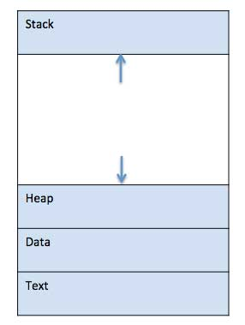
Process (CO2)

Slide 39
Process State(CO2)
As a process executes, it changes state
New: The process is being created.
Running: Instructions are being executed.
Waiting: The process is waiting for some event to occur.
Ready: The process is waiting to be assigned to a processor
Terminated: The process has finished execution.

Slide 40
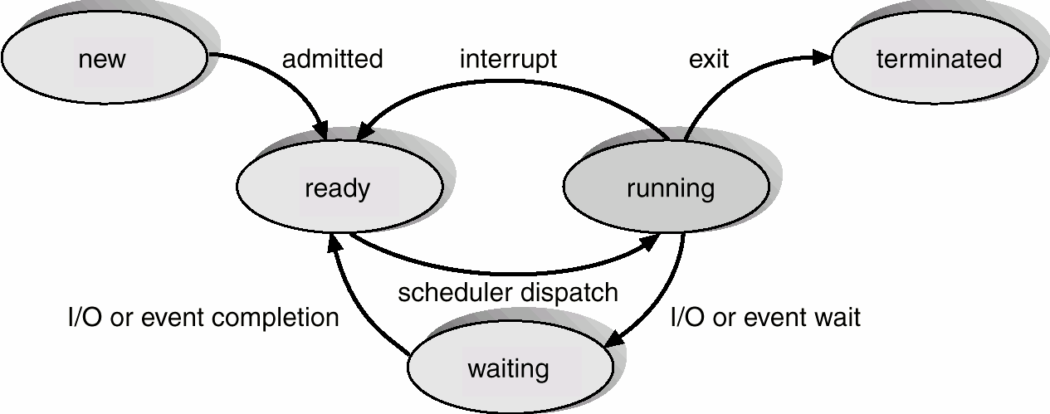
Process Transition Diagram(CO2)
}

Slide 41
Process Control Block (PCB)(CO2)
Information associated with each process.
Process ID
Process state
Program counter
CPU registers
CPU scheduling information
Memory-management information
Accounting information
I/O status information

Slide 42
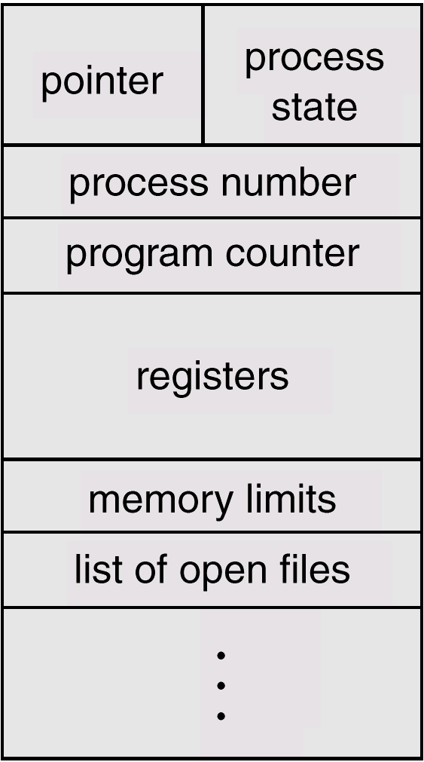
Process Control Block (PCB)(CO2)

Slide 43
Thread(CO2)
A thread is a basic unit of CPU utilization
Thread is an execution unit which consists of its own program counter, a stack, and a set of registers.
Threads are also known as Lightweight processes
Threads are popular way to improve application through parallelism.
As each thread has its own independent resource for process execution, multpile processes can be executed parallely by increasing number of threads.

Slide 44
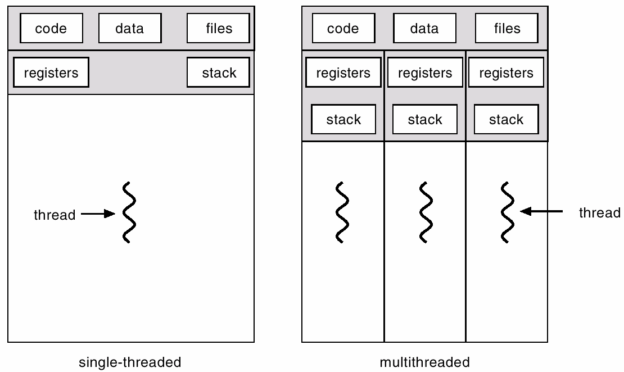
Single and Multithreaded Processes(CO2)

Slide 45











Multithreaded Server Architecture (CO2)

Slide 46
Benefits of Multithreading(CO2)
Responsiveness – may allow continued execution if part of process is blocked, especially important for user interfaces
Resource Sharing – threads share resources of process, easier than shared memory or message passing
Economy – cheaper than process creation, thread switching lower overhead than context switching
Scalability – process can take advantage of multiprocessor architectures

Slide 47
User Threads(CO2)
User Threads
Thread management done by user-level threads library
No need for kernel intervention
Drawback : all may run in single process. If one blocks, all block.
Examples
POSIX Pthreads
Mach C-threads
Solaris threads

Slide 48
Kernel Threads(CO2)
Kernel Threads
Supported by the Kernel
Generally slower to create than user threads
If one blocks another in the application can be run
Can be scheduled on different CPUs in multiprocessor
Examples
Windows 95/98/NT/2000
Solaris
Tru64 UNIX
BeOS
Linux

Slide 49
Multithreading Models(CO2)
Many-to-One
One-to-One
Many-to-Many

Slide 50
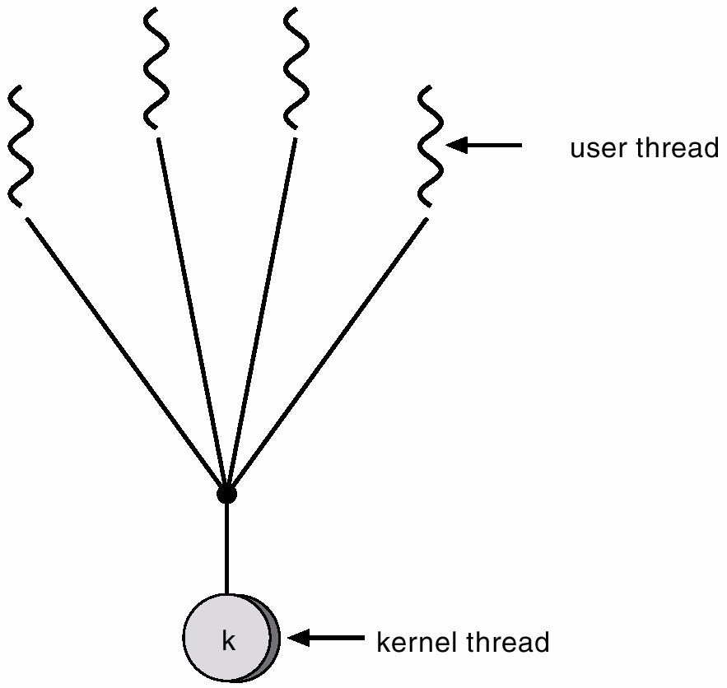
Many-to-One(CO2)
Many user-level threads mapped to single kernel thread.
Used on systems that do not support kernel threads.

Slide 51
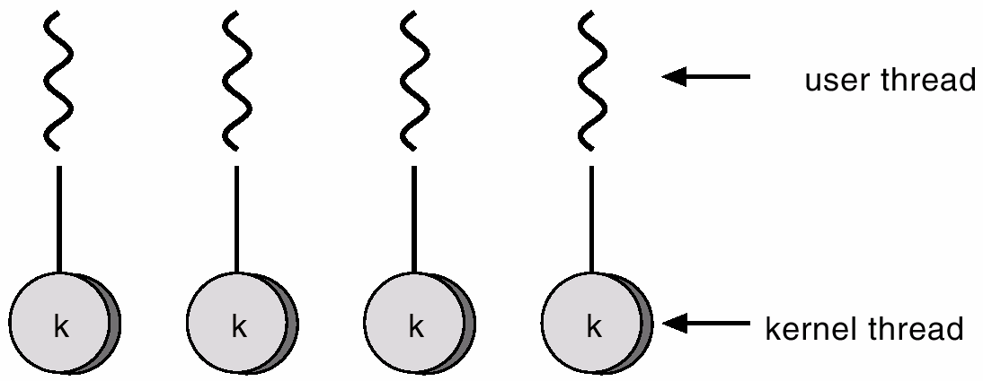
One-to-One(CO2)
Each user-level thread maps to kernel thread.
Examples
Windows 95/98/NT/2000
OS/2

Slide 52
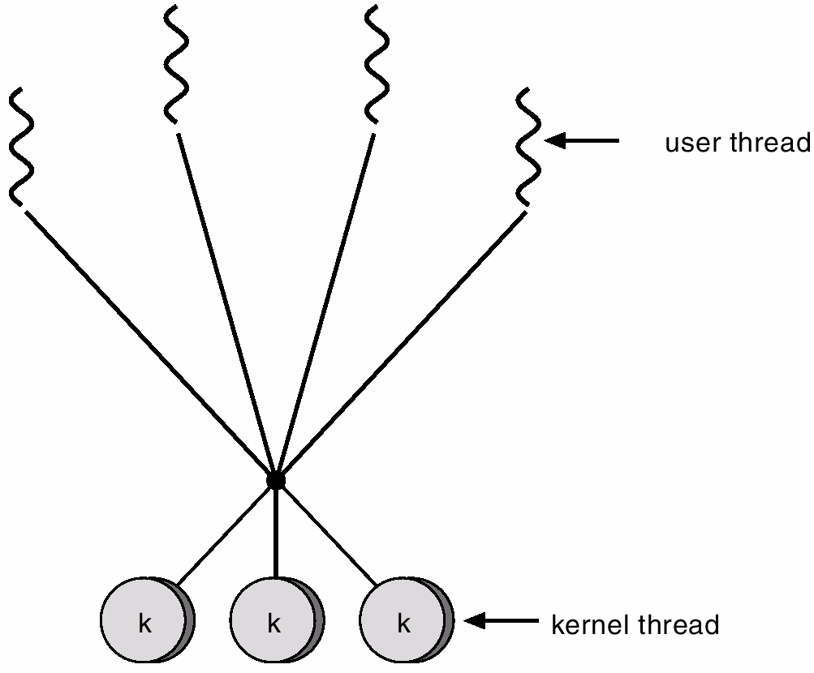
Many-to-Many Model(CO2)
Many user-level threads mapped to single kernel thread
One thread blocking causes all to block
Multiple threads may not run in parallel on muticore system because only one may be in kernel at a time
Few systems currently use this model
Examples:
Solaris Green Threads
GNU Portable Threads

Slide 53
Types of Schedulers(CO2)
Long-term scheduler (or job scheduler) – selects which processes should be brought into the ready queue.
Short-term scheduler (or CPU scheduler) – selects which process should be executed next and allocates CPU
Operating System Concets

Slide 54
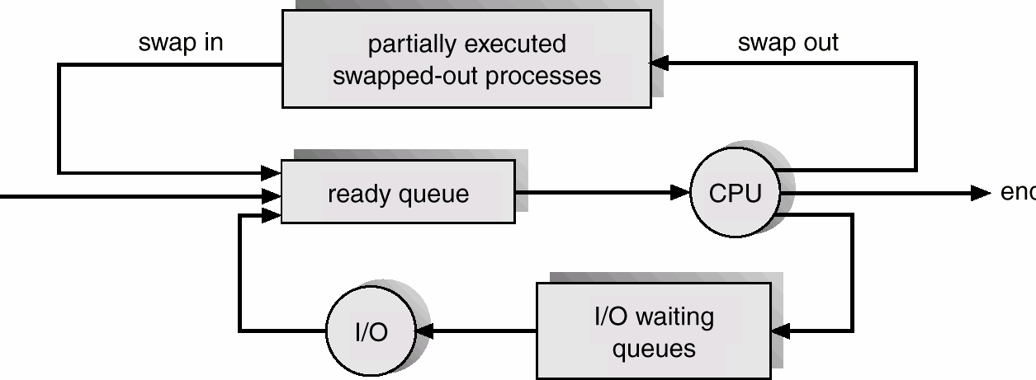
Addition of Medium Term Scheduling(CO2)

Slide 55
Process Scheduling Queues(CO2)
Job queue – set of all processes in the system.
Ready queue – set of all processes residing in main memory, ready and waiting to execute.
Device queues – set of processes waiting for an I/O device.
Processes migrate between the various queues

Slide 56
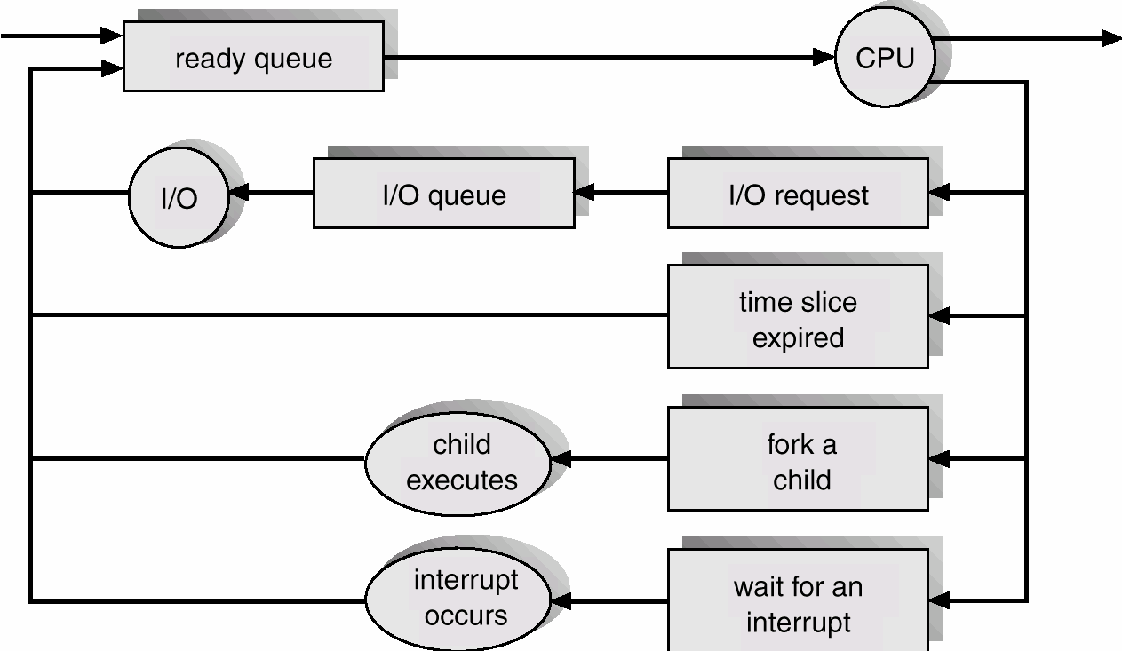
Representation of Process Scheduling(CO2)

Slide 57
CPU Scheduler(CO2)
Selects from among the processes in memory (i.e. Ready Queue) that are ready to execute, and allocates the CPU to one of them.
Preemptive: allows a process to be interrupted in the midst of its CPU execution, taking the CPU away to another process
Non- Preemptive: ensures that a process relinquishes control of CPU when it finishes with its current CPU burst
Operating System Concepts

Slide 58
CPU Scheduler(CO2)
CPU scheduling decisions may take place when a process:
Switches from running to waiting state.
Switches from running to ready state.
Switches from waiting to ready.
Terminates.
Preemptive: allows a process to be interrupted
Non- Preemptive: allows a process finishes with its current CPU burst
Scheduling under 1 and 4 is nonpreemptive.
All other scheduling is preemptive.

Slide 59
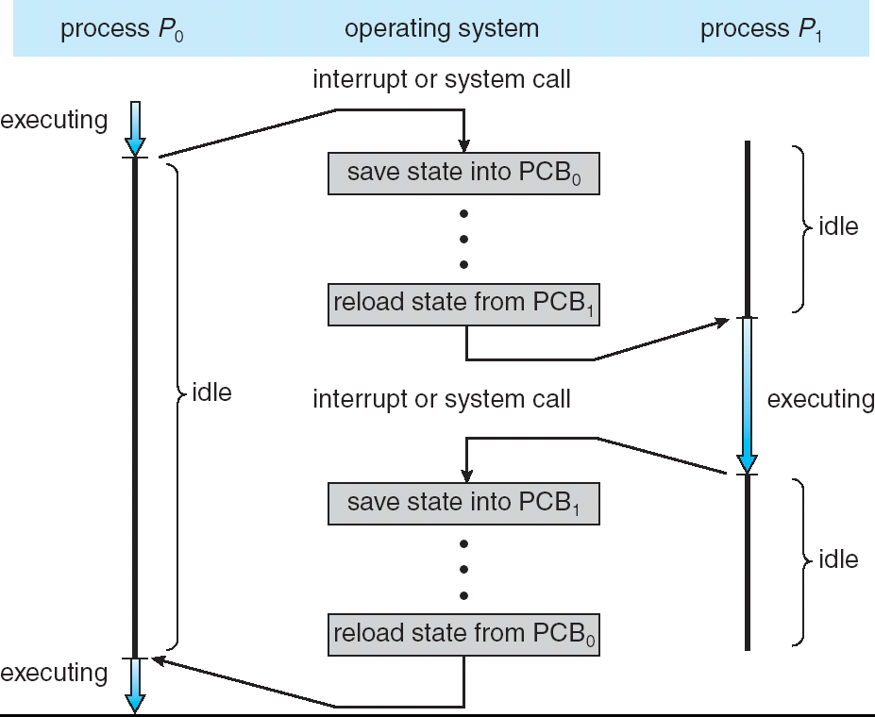
Context Switching(CO2)

Slide 60
Dispatcher(CO2)
Dispatcher module gives control of the CPU to the process selected by the short-term scheduler; this involves:
switching context
switching to user mode
jumping to the proper location in the user program to restart that program
Dispatch latency – time it takes for the dispatcher to stop one process and start another running.

Slide 61
Daily Quiz
What is Process? Explain PCB block.
What is difference between job and process.
What is process scheduler? Explain Characteristics of good process scheduler.
What do you mean by threads? Explain its types.

Slide 62
Daily Quiz
5. A Process Control Block(PCB) does not contain which of the following?
Code
Stack
Bootstrap program
Data
6. The number of processes completed per unit time is known as
Output
Throughput
Efficiency
capacity

Slide 63
Topic mapping with CO
Topic | CO
Scheduling Criteria | CO2
CPU Scheduling algorithms | CO2

Slide 64
Topic Objectives
Topic | Objective
 | Students will be able to
Scheduling Criteria | Understand different types of scheduling.
CPU Scheduling algorithms | Know about the how CPU Scheduling algorithms works.

Slide 65
Scheduling Criteria(CO2)
CPU utilization – keep the CPU as busy as possible
Throughput – Number of processes that complete their execution per time unit
Turnaround time – amount of time to execute a particular process (finishing time – arrival time)
Waiting time – amount of time a process has been waiting in the ready queue
Response time – amount of time it takes from when a request was submitted until the first response is produced, not output(for time-sharing environment)

Slide 66
CPU Scheduling algorithms(CO2)
CPU Scheduling Algorithms
First Come First Serve(FCFS) Scheduling.
Shortest-Job-First(SJF) Scheduling.
Priority Scheduling.
Round Robin(RR) Scheduling.
Multilevel Queue Scheduling.
Multilevel Feedback Queue Scheduling.

Slide 67
CPU Scheduling algorithms(CO2)
First Come First Serve(FCFS) Scheduling
In FCFS, the process which arrives first in front of CPU will be executed first by the CPU.
It is a non-preemptive type of scheduling algorithm, i.e. in this scheduling algorithm priority of processes does not matter, or whatever the priority of the process is, the process will be executed in the manner they arrived in front of the CPU.

Slide 68
First-Come, First-Served (FCFS) Scheduling(CO2)
Process
P₁ P₂ P₃
Burst Time
24
3
3
Suppose that the processes arrive in the order: P₁ , P₂ , P_{3.} The Gantt Chart for the schedule is:
P₁ | P₂ | P₃
0 24 27
Waiting time for P₁ = 0; P₂ = 24; P₃ = 27
Average waiting time: (0 + 24 + 27)/3 = 17
30

Slide 69
FCFS Scheduling (CO2)
Suppose that the processes arrive in the order P₂ , P₃ , P₁ .
The Gantt chart for the schedule is:
P₂ | P₃ | P₁
0 3 6
Waiting time for P₁ = 6; P₂ = 0; P₃ = 3
30
Average waiting time: (6 + 0 + 3)/3 = 3
Much better than previous case.
Convoy effect short process behind long process

Slide 70
FCFS Scheduling (CO2)
Characteristics of FCFS method:
It offers non-preemptive and pre-emptive scheduling algorithm.
Jobs are always executed on a first-come, first-serve basis
It is easy to implement and use.
However, this method is poor in performance, and the general wait time is quite high.

Slide 71
Problems with FCFS Scheduling (CO2)
Below we have a few shortcomings or problems with the FCFS scheduling algorithm:
It is Non Pre-emptive algorithm, which means the process priority doesn't matter.If a process with very least priority is being executed, more like daily routine backup process, which takes more time, and all of a sudden some other high priority process arrives, like interrupt to avoid system crash, the high priority process will have to wait, and hence in this case, the system will crash, just because of improper process scheduling.
Not optimal Average Waiting Time.
Resources utilization in parallel is not possible, which leads to Convoy Effect, and hence poor resource(CPU, I/O etc) utilization.

Slide 72
Shortest-Job-First (SJR) Scheduling(CO2)
This algorithm associates with each process the length of the process's next CPU burst. When the CPU is available, it is assigned to the process that has the smallest next CPU burst. If the next CPU bursts of two processes are the same, FCFS scheduling is used to break the tie.

Slide 73
Shortest-Job-First (SJR) Scheduling(CO2)
Two schemes:
Non-preemptive – once CPU given to the process it cannot be preempted until completes its CPU burst.
Preemptive – if a new process arrives with CPU burst length less than remaining time of current executing process, preempt. This scheme is know as the Shortest-Remaining-Time-First (SRTF).
SJF is optimal – gives minimum average waiting time for a given set of processes.

Slide 74
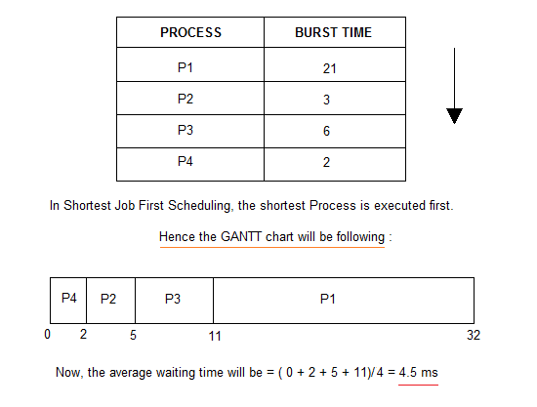
Example of Non-Preemptive SJF(CO2)

Slide 75
Example of Preemptive SJF(CO2)
Process Arrival Time | Burst Time
P₁ 0.0 | 7
P₂ 2.0 | 4
P₃ 4.0 | 1
P₄ 5.0 | 4
SJF (preemptive)
P₁ |  | P₂ |  | P₃ | P₂ |  | P₄ |  |  |  | P₁
0
2 4 5 7
11
16
Average waiting time = (9 + 1 + 0 +2)/4 = 3

Slide 76
Priority Scheduling(CO2)
Priority scheduling is a method of scheduling processes based on priority. In this method, the scheduler selects the tasks to work as per the priority.
Priority scheduling also helps OS to involve priority assignments. The processes with higher priority should be carried out first, whereas jobs with equal priorities are carried out on a round-robin or FCFS basis.
Priority can be decided based on memory requirements, time requirements, etc.

Slide 77
Priority Scheduling(CO2)
Types of Priority Scheduling Algorithm:-
Preemptive Priority Scheduling: If the new process arrived at the ready queue has a higher priority than the currently running process, the CPU is preempted, which means the processing of the current process is stopped and the incoming new process with higher priority gets the CPU for its execution.
Non-Preemptive Priority Scheduling: In case of non-preemptive priority scheduling algorithm if a new process arrives with a higher priority than the current running process, the incoming process is put at the head of the ready queue, which means after the execution of the current process it will be processed.

Slide 78
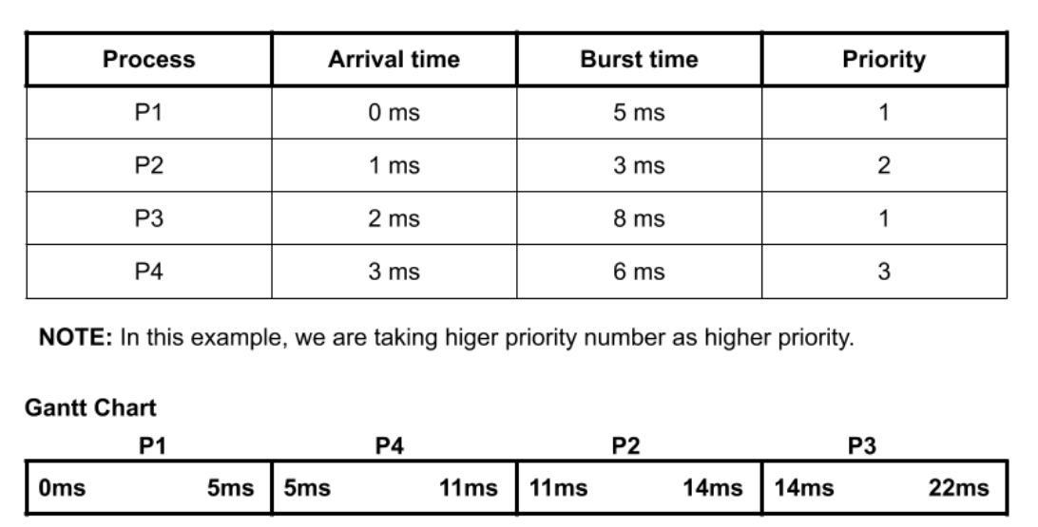
Priority Scheduling (Non-preemptive)
Example (CO2)

Slide 79
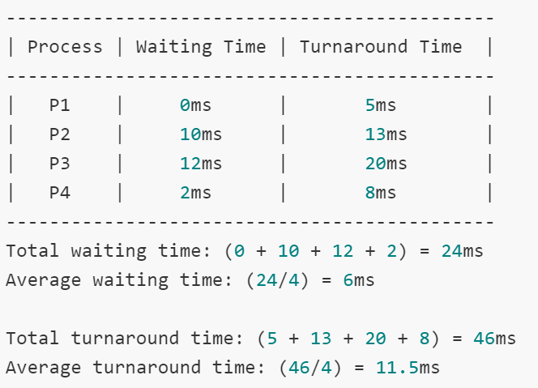
Priority Scheduling (Non-preemptive)
Example (CO2)

Slide 80
Priority Scheduling(CO2)
Advantages of priority scheduling (non-preemptive):
Higher priority processes like system processes are executed first.
Disadvantages of priority scheduling (non-preemptive):
It can lead to starvation if only higher priority process comes into the ready state.
If the priorities of more two processes are the same, then we have to use some other scheduling algorithm.

Slide 81
Priority Scheduling(CO2)
Problem with Priority Scheduling Algorithm
In priority scheduling algorithm, the chances of indefinite blocking or starvation.
A process is considered blocked when it is ready to run but has to wait for the CPU as some other process is running currently.
But in case of priority scheduling if new higher priority processes keeps coming in the ready queue then the processes waiting in the ready queue with lower priority may have to wait for long durations before getting the CPU for execution.

Slide 82
Priority Scheduling(CO2)
Using Aging Technique with Priority Scheduling
To prevent starvation of any process, we can use the concept of aging where we keep on increasing the priority of low-priority process based on the its waiting time.
For example, if we decide the aging factor to be 0.5 for each day of waiting, then if a process with priority 20(which is comparatively low priority) comes in the ready queue. After one day of waiting, its priority is increased to 19.5 and so on. Doing so, we can ensure that no process will have to wait for indefinite time for getting CPU time for processing.

Slide 83
Round Robin (CO2)
Round Robin(RR) scheduling algorithm is mainly designed for time-sharing systems. This algorithm is similar to FCFS scheduling, but in Round Robin(RR) scheduling, preemption is added which enables the system to switch between processes.
A fixed time is allotted to each process, called a quantum, for execution.
Once a process is executed for the given time period that process is preempted and another process executes for the given time period.
Context switching is used to save states of preempted processes.
This algorithm is simple and easy to implement
It is important to note here that the length of time quantum is generally from 10 to 100 milliseconds in length.

Slide 84
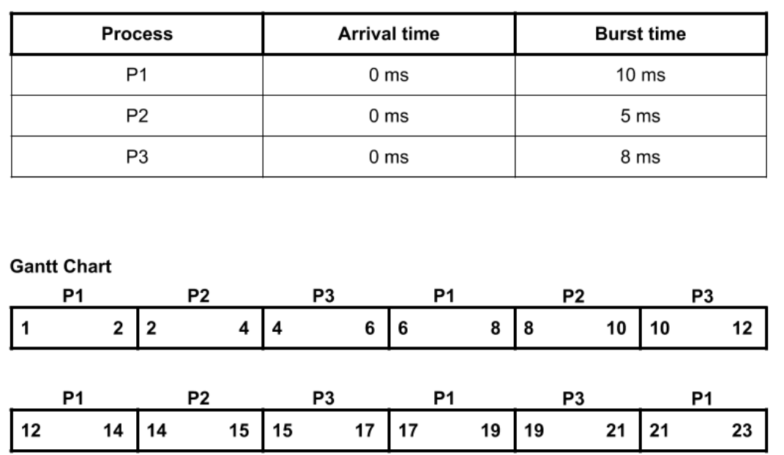
Example of RR (CO2)

Slide 85
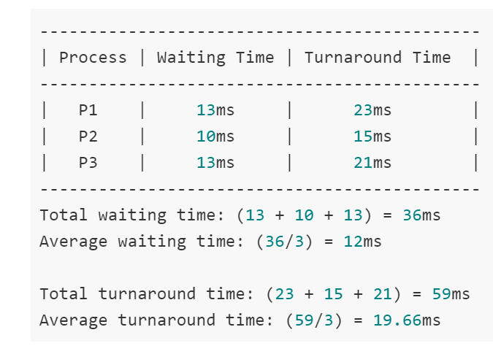
Example of RR (CO2)

Slide 86
Advantages and Disadvantages of RR (CO2)
Advantages of round-robin:
No starvation will be there in round-robin because every process will get chance for its execution.
Used in time-sharing systems.
Disadvantages of round-robin:
We have to perform a lot of context switching here, which will keep the CPU idle.

Slide 87
Multilevel Queue(CO2)
Ready queue is partitioned into separate queues: foreground (interactive)
background (batch)
Each queue has its own scheduling algorithm,
foreground – RR
background – FCFS
Scheduling must be done between the queues.
Fixed priority scheduling; (i.e., serve all from foreground then from background). Possibility of starvation.
Time slice – each queue gets a certain amount of CPU time which it can schedule amongst its processes; i.e., 80% to foreground in RR
20% to background in FCFS

Slide 88
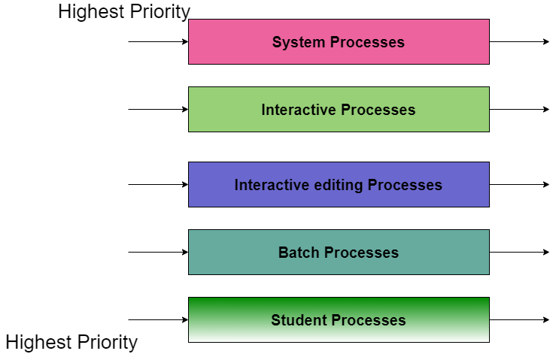
Multilevel Queue Scheduling(CO2)

Slide 89
Multilevel Queue Scheduling(CO2)
System Process The Operating system itself has its own process to run and is termed as System Process.
Interactive Process The Interactive Process is a process in which there should be the same kind of interaction (basically an online game ).
Batch Processes Batch processing is basically a technique in the Operating system that collects the programs and data together in the form of the batch before the processing starts.
Student Process The system process always gets the highest priority while the student processes always get the lowest priority.

Slide 90
Multilevel Feedback Queue(C03)
In a multilevel queue-scheduling algorithm, processes are permanently assigned to a queue on entry to the system. Processes do not move between queues. In general, a multilevel feedback queue scheduler is defined by the following parameters:
The number of queues.
The scheduling algorithm for each queue.
The method used to determine when to upgrade a process to a higher-priority queue.
The method used to determine when to demote a process to a lower-priority queue.
The method used to determine which queue a process will enter when that process needs service.

Slide 91
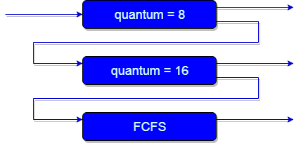
Multilevel Feedback Queues(CO2)

Slide 92
Example of Multilevel Feedback Queues(CO2)
Three queues:
Q₀ – time quantum 8 milliseconds
Q₁ – time quantum 16 milliseconds
Q₂ – FCFS
Scheduling
A new job enters queue Q₀ which is served FCFS. When it gains CPU, job receives 8 milliseconds. If it does not finish in 8 milliseconds, job is moved to queue Q₁.
At Q₁ job is again served FCFS and receives 16 additional milliseconds. If it still does not complete, it is preempted and moved to queue Q₂.

Slide 93
Need of Multilevel Feedback Queues(CO2)
This scheduling is more flexible than Multilevel queue scheduling.
This algorithm helps in reducing the response time.
In order to optimize the turnaround time, the SJF algorithm is needed which basically requires the running time of processes in order to schedule them. As we know that the running time of processes is not known in advance. Also, this scheduling mainly runs a process for a time quantum and after that, it can change the priority of the process if the process is long. Thus this scheduling algorithm mainly learns from the past behavior of the processes and then it can predict the future behavior of the processes.

Slide 94
Advantages of Multilevel Feedback Queues(CO2)
Advantages of MFQS
This is a flexible Scheduling Algorithm
This scheduling algorithm allows different processes to move between different queues.
In this algorithm, A process that waits too long in a lower priority queue may be moved to a higher priority queue which helps in preventing starvation.

Slide 95
Disadvantages of Multilevel Feedback Queues(CO2)
Disadvantages of MFQS
This algorithm is too complex.
As processes are moving around different queues which leads to the production of more CPU overheads.
In order to select the best scheduler this algorithm requires some other means to select the values.

Slide 96
Multiple-Processor Scheduling(CO2)
CPU scheduling more complex when multiple CPUs are available.
Homogeneous processors within a multiprocessor.
Load sharing or load balancing

Slide 97
Real-Time Scheduling(CO2)
Hard real-time systems – required to complete a critical task within a guaranteed amount of time.
Soft real-time computing – requires that critical processes receive priority over less fortunate ones.

Slide 98
Daily Quiz for Module (CPU Scheduling)
Which module gives control of the CPU to the process selected by the short-term scheduler? a) dispatcher b) interrupt c) scheduler d) none of the mentioned.
2. Which scheduling algorithm allocates the CPU first to the process that requests the CPU first? a) first-come, first-served scheduling b) shortest job scheduling c) priority scheduling d) none of the mentioned
3. In priority scheduling algorithm ____________ a) CPU is allocated to the process with highest priority b) CPU is allocated to the process with lowest priority c) Equal priority processes can not be scheduled d) None of the mentioned

Slide 99
Daily Quiz for Module (CPU Scheduling)
4. In priority scheduling algorithm, when a process arrives at the ready queue, its priority is compared with the priority of ____________ a) all process b) currently running process c) parent process d) init process
5. Which algorithm is defined in Time quantum? a) shortest job scheduling algorithm b) round robin scheduling algorithm c) priority scheduling algorithm d) multilevel queue scheduling algorithm
Process are classified into different groups in ____________ a) shortest job scheduling algorithm b) round robin scheduling algorithm c) priority scheduling algorithm d) multilevel queue scheduling algorithm

Slide 100
Daily Quiz
1. A solution to the problem of indefinite blockage of low – priority processes is ____________
Starvation
Wait queue
Ready queue
Aging
2. The switching of the CPU from one process or thread to another is called ____________
process switch
task switch
context switch
all of the mentioned

Slide 101
Daily Quiz
3. The processes that are residing in main memory and are ready and waiting to execute are kept on a list called _________
job queue
ready queue
execution queue
process queue
4. In priority scheduling algorithm ____________
CPU is allocated to the process with highest priority
CPU is allocated to the process with lowest priority
Equal priority processes can not be scheduled
None of the mentioned

Slide 102
Daily Quiz
5. The interval from the time of submission of a process to the time of completion is termed as ____________
waiting time
turnaround time
response time
throughput
6. In the following cases non – preemptive scheduling occurs?
When a process switches from the running state to the ready state
When a process goes from the running state to the waiting state
When a process switches from the waiting state to the ready state
All of the mentioned

Slide 103
Daily Quiz
9. Scheduling is done so as to ____________
increase CPU utilization
decrease CPU utilization
keep the CPU more idle
none of the mentioned
10. A solution to the problem of indefinite blockage of low – priority processes is ____________
Starvation
Wait queue
Ready queue
Aging

Slide 104
Weekly Assignment
Differentiate between preemptive and nonpreemptive scheduling.
List out the necessary conditions for deadlock to occur..
Define PCB
List out the various scheduling criteria for CPU Scheduling.

Slide 105
MCQ
The switching of the CPU from one process or thread to another is called ____________
a) process switch
b) task switch
c) context switch
d) all of the mentioned
2. The systems which allow only one process execution at a time, are called __________
a) uniprogramming systems b) uniprocessing systems c) unitasking systems d) none of the mentioned

Slide 106
MCQ
3. Which of the following is not the state of a process?
New
Old
Waiting
Running
4. A single thread of control allows the process to perform __________
only one task at a time
multiple tasks at a time
only two tasks at a time
all of the mentioned

Slide 107
MCQ
5. process can be terminated due to __________ a) normal exit b) fatal error c) killed by another process d) all of the mentioned
6. What is the ready state of a process? a) when process is scheduled to run after some execution b) when process is unable to run until some task has been completed c) when process is using the CPU d) none of the mentioned

Slide 108
MCQ
9. This is dynamically allocated memory to a process during its run time.
a)Heap b). Stack c) Queue d) Data
10. How many state are there in Process Life Cycle?
A. 4 B. 5 C. 6 D. 7

Slide 109
Glossary Questions
Which one of the following can not be scheduled by the kernel ____________
Module gives control of the CPU to the process selected by the short-term scheduler ____________
The processes that are residing in main memory and are ready and waiting to execute are kept on a list called: ___________
4. The interval from the time of submission of a process to the time of completion is termed as: ___________
5. Process are classified into different groups in : ___________
(multilevel queue scheduling algorithm, Dispatcher, Ready Queue, Turnaround Time, User level Threads.)

Slide 110
Glossary Questions
Choose the correct option:
CPU scheduling is the basis of ____________.
2. The two steps of a process execution are ____________.
3. An I/O bound program will typically have ____________.
4. Scheduling is done so as to : ____________.
(I/O Burst, CPU Burst , many very short CPU bursts ,multiprogramming operating system, increase CPU utilization)

Slide 111
Faculty Video Links, Youtube & NPTEL Video Links and Online Courses Details
Youtube/other Video Links
https://www.youtube.com/watch?v=_zOTMOubT1M
https://www.youtube.com/playlist?list=PLmXKhU9FNesSFvj6gASuWmQd23Ul5omtD
https://www.youtube.com/watch?v=x_UpLHXF9dU
https://www.youtube.com/watch?v=cviEfwtdcEE
https://nptel.ac.in/courses/106108101

Slide 112
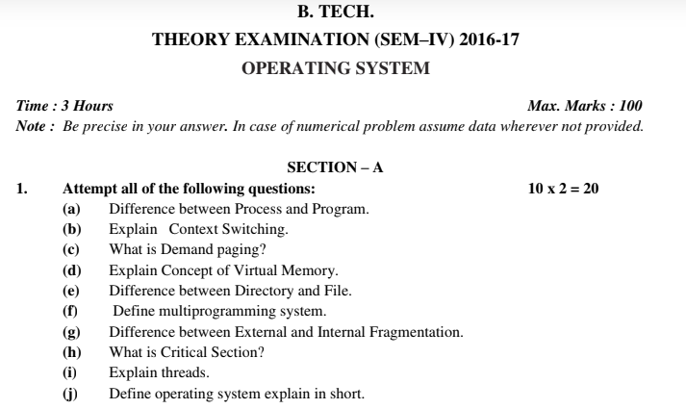
Old Question Papers

Slide 113
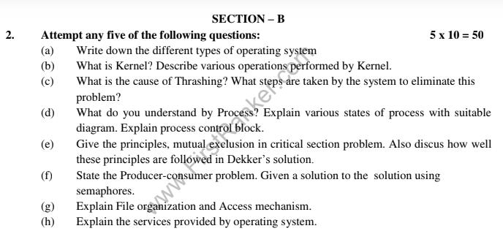
Old Question Papers
Operating System Concets

Slide 114
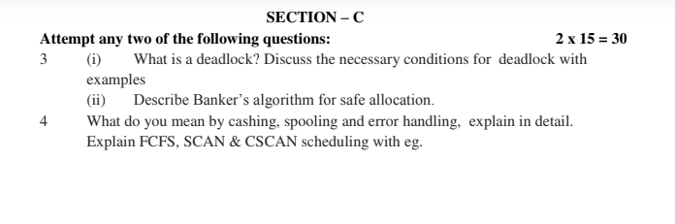
Old Question Papers
Operating System Concets

Slide 115
Expected Questions for University Exam
Draw the labeled process state transition diagram with describing the various process states.
Write a note on Deadlock Prevention.
Explain Multi Level Queue Scheduling.
Explain Short term, Middle term and Long term Schedulers.
Write down the steps of Deadlock Detection
Define PCB.
List out the various scheduling criteria for CPU Scheduling.
List out the necessary conditions for deadlock to occur.
Operating System Concets

Slide 116
Expected Questions for University Exam
Draw Gannt chart and find average waiting time and response time using
FCFS
Round Robin (quantum=2)
SJF and SRTF
9. Consider the following set of four processes, with the length of CPU burst time given in milliseconds
Process Arrival Time Burst Time
P₁ 0 7
P₂ 2 4
P₃ 4 1
P₄ 5 4
Operating System Concets

Slide 117
Expected Questions for University Exam
10. Let us consider the following snapshot
What is the content of matrix need?
Is the system in a safe state or not?
If a request from process P₁ arrives for (1,0,2) can request be granted immediately or not?
Allocation Max Available
A B C A B C A B C
P₀ 0 1 0 7 5 3 3 3 2
P₁ 2 0 0 3 2 2
P₂ 3 0 2 9 0 2
P₃ 2 1 1 2 2 2
P₄ 0 0 2 4 3 3
Operating System Concets

Slide 118
Summary
In this module, we have studied the following:
Process Concept
Process State
Process Transition Diagram
Process Control Block (PCB)
Thread
User thread
Kernel thread
Single and Multithreaded Processes
Multithreading Models
Many-to-One
One-to-One
Many-to-Many Model
Types of Schedulers
Context Switching
Operating System Concets

Slide 119
Recap of Unit
In this module, we have studied the following:
Scheduling Concept
Performance Criteria
Process Concept
Process State
Process Transition Diagram
Process Control Block (PCB)
Thread
User thread
Kernel thread
Single and Multithreaded Processes
Multithreading Models
Many-to-One
One-to-One
Many-to-Many Model
Operating System Concets

Slide 120
Recap of Unit
Types of Schedulers
CPU Scheduling Algorithms
First Come First Serve(FCFS) Scheduling.
Shortest-Job-First(SJF) Scheduling.
Priority Scheduling.
Round Robin(RR) Scheduling.
Multilevel Queue Scheduling.
Multilevel Feedback Queue Scheduling.
Multiple-Processor Scheduling
Operating System Concets

Slide 121
References
Books :
Silberschatz, Galvin and Gagne, “Operating Systems Concepts”, Wiley
SibsankarHalder and Alex A Aravind, “Operating Systems”, Pearson Education
Harvey M Dietel, “ An Introduction to Operating System”, Pearson Education
D M Dhamdhere, “Operating Systems : A Concept basedApproach”, McGraw Hill.
Charles Crowley, “Operating Systems: A Design-Oriented Approach”, Tata McGraw Hill Education”.
Stuart E. Madnick & John J. Donovan, “ Operating Systems”, Tata McGraw
Operating System Concets

Slide 122
Thank You

